Slide 1

E2AP 1.01 (O-RAN.WG3.E2AP-v01.01)
Rahul Banerji (Samsung Open Source team)

Slide 2
Agenda
New Flows Introduced
Flows Affected
Suggested Protobuf changes
E2Mgr changes
E2Term changes
E2Sim
Backwards Compatibility

Slide 3
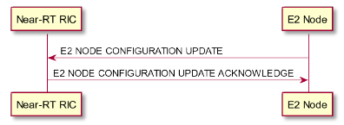
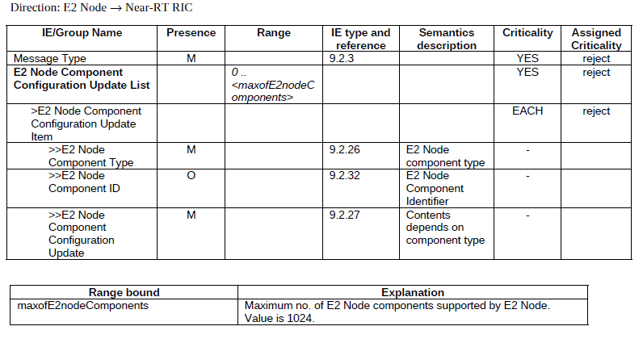
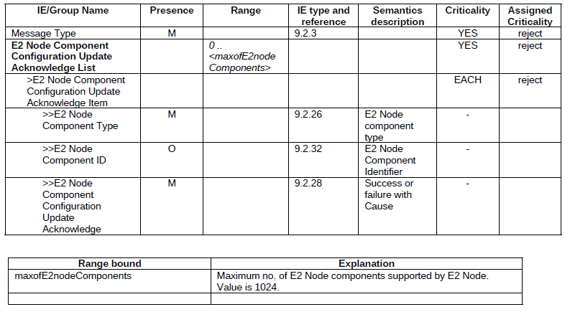
E2 Node Configuration
Added as part of new spec
The purpose of the E2 Node Configuration Update procedure is to update application level E2 Node configuration data needed for E2 Node and Near-RT RIC to interoperate correctly over the E2 interface.
Format:
E2 Node conf Update
E2 Node conf Update Ack

Slide 4
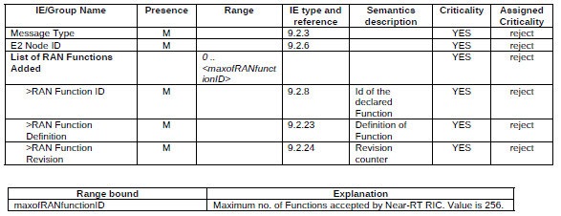
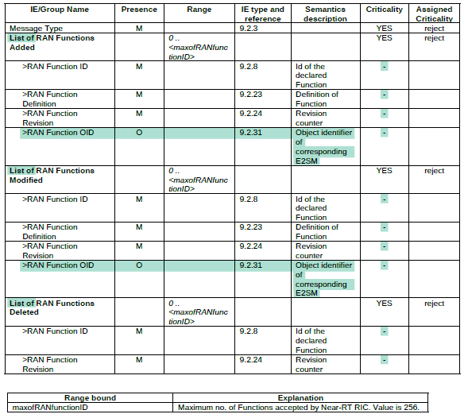
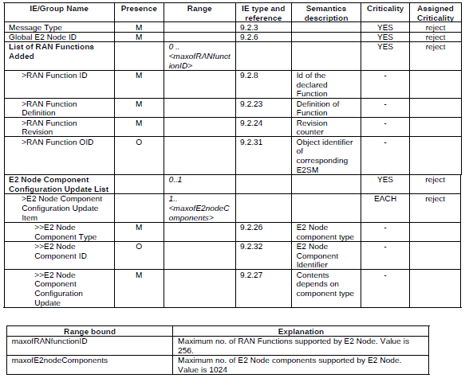
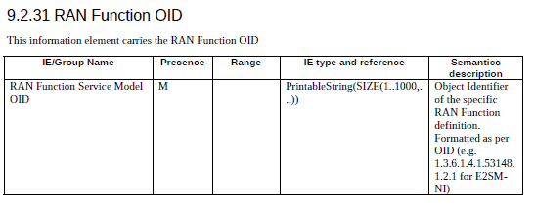
Flows Affected
E2 Setup req/Resp
RIC Service Update only
Ran Function OID
Before
Now

Slide 5
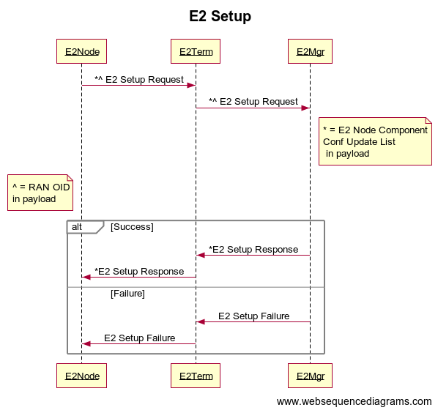
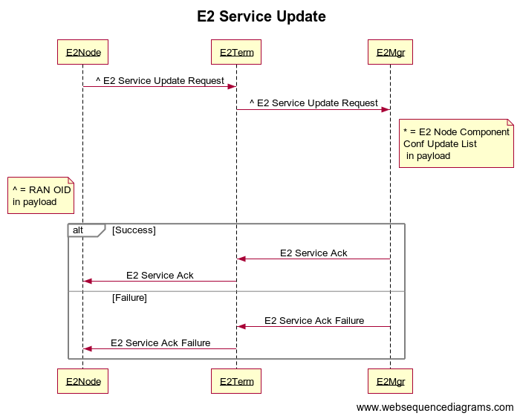
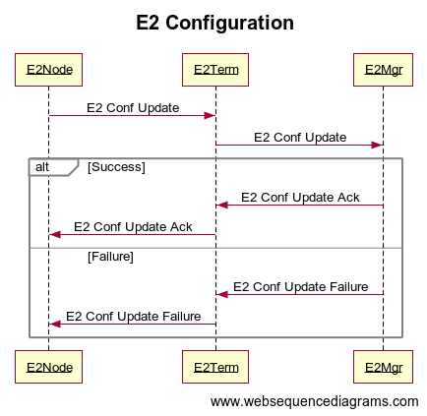
Code Flows

Slide 6
Suggested Protobuf/Rnib Changes
message RanFunction {
uint32 ran_function_id = 1;
string ran_function_definition = 2;
uint32 ran_function_revision = 3;
string ran_function_oid = 4;//new
}
New Message
message E2NodeComponentConfig{
uint64 e2NodeComponentID = 1; //optional
oneof e2NodeComponentType{
EnbType enbtype =2;
GnbType gnbtype=3;
}
//or skip as redundant
string e2nodeComponentConfigUpdate = 4;
} //New
Existing messages modified
message Enb{
EnbType enb_type = 1;
repeated ServedCellInfo served_cells = 2;
repeated string gu_group_ids = 3;
repeated E2NodeComponentConfig e2NodeComponentConfig = 4; //new
}
The following changes will need to be added to rnib
Associated DB function calls to retrieve e2config from DB has to be added in sdl/rnibreader/rnibwriter layer
Removed as part of Design 2.0 ->
message Gnb{
repeated ServedNRCell served_nr_cells = 1;
repeated RanFunction ran_functions = 2;
GnbType gnb_type = 3;
repeated E2NodeComponentConfig e2NodeComponentConfig = 4; //new
}

Slide 7
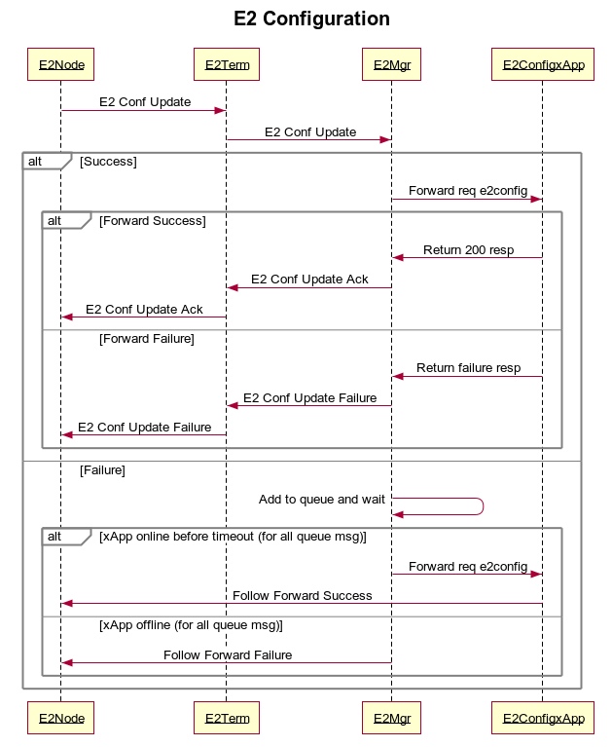
E2NodeConfigHandler xApp
All E2 Configuration handling will be done by this xApp
The E2Manager will just forward all ‘E2 Node Component Configuration Update List’ directly to this xApp
xApp will handle all storage (to rnib or somewhere else) and will support the following standard rest Api calls to E2Mgr (or other xApps):
GET /e2config/gnb/{ranName} (xapp->e2mgr)
POST /e2config/gnb/{ranName} (e2mgr->xapp)
GET /e2config/enb/{ranName} (xapp->e2mgr)
POST /e2config/enb/{ranName} (e2mgr->xapp)
GET /e2config/health (Heartbeat of e2config xapp | e2mgr->xapp)
The entire business logic to decode and store E2 node config should be proprietary and implemented by the user (this will not be a part of O-RAN SC due to licence conflicts)
This xApp must be stateless, and all of its state must be persistent for the sake of consistency

Slide 8
E2Mgr Main Changes
New RMR API added for E2Configuration changes
This api was not a part of e2ap1.0 so no issues with backward compatibility
Protobuf changes will take care of database layer as well as storage
E2Mgr to add a queue to store e2config msg in case the config xApp crashes or goes offline temporarily
The queue will be in memory by default, but interface will be provided for future extension using external libraries
New http api to fetch E2Configuration (stretch goal)
GET /e2config/enb/{ranName} //stretch
GET /e2config/gnb/{ranName}

Slide 9
E2Mgr Main Changes
E2setup model xml file needs to be changed, add ran OID and e2config pdu to be kept as string
Check needs to be added for new fields in the e2setup request and e2 service update and depreciation warning to be generated if using e2ap1.0
If api call comes for e2ap1.0, all e2ap1.1 new fields will be set to null
Need to add new UT for e2setup for newly added fields (e2config and ranF OID)
Not handling edge cases where e2ap1.0 and 1.1 are used by the same e2node at same time, i.e e2ap1.0 based setup request but config update request follows e2ap1.1

Slide 10
E2Term
ASN support needs to be added for xml to per encoding and vice versa for associated affected flows
Not sure how asn handles optional fields yet
need to explore w.r.t backwards compatibility
Need to add support for associated flows (both on sctp and e2mgr side)
Will not be supporting Prometheus counters as part of initial release

Slide 11
E2SIM
Add support for e2config msg and oid field
E2setup
E2confupdate
E2serviceupdate

Slide 12
Backwards Compatibility
E2term will need to add support for new messages and implement the interface to talk with e2config xapp
Update E2setup and ric service query model files as well as need to add check to all associated flows
E2Mgr, will keep a check for optional fields and log a depreciation warning, e.g for ran oid, and e2config pdu

Slide 13
Thank You
Any questions?

Slide 14
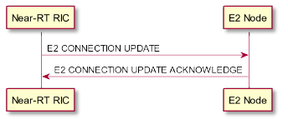
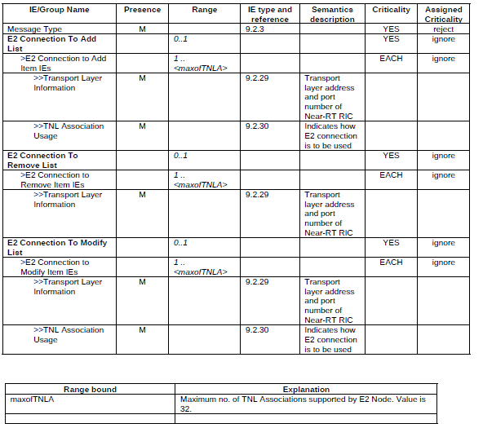
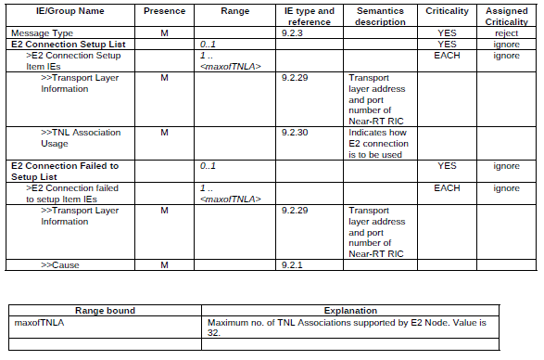
E2 Node Connection
Added as part of new spec
The purpose of the E2 Connection Update procedure is to update the E2 interface connection between the E2 Node and Near-RT RIC
Format:
E2 connection Update
E2 connection Update Ack

